Slide 1
Capstone Project Applied Data Science Capstone by IBM/Coursera
Han, Donghee

Slide 2
Table of contents
Introduction: Business Problem
Data
Methodology
Analysis
Results and Discussion
Conclusion

Slide 3
Introduction : Business Problem
find an optimal location for delivery service company
This project is targeting Korean student in KAIST(Korea Advanced Institute of Science and Technology)
We are trying to make 'Drone Delivery Service'
looking for the optimal location for our 'Drone Base‘

Slide 4
Data
- number and location of restaurants clusters near KAIST
- distance of clusters from KAIST
- number of Chinese restaurants in the clusters (Chinese food is most popular delivery food)
Get Data from Google Maps API & Foursquare API

Slide 5
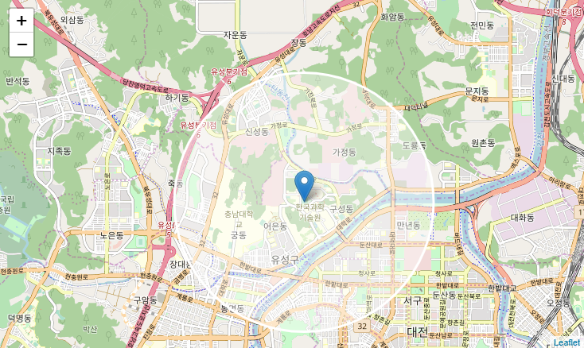
Data
Get KAIST Location Data from Google Maps API

Slide 6
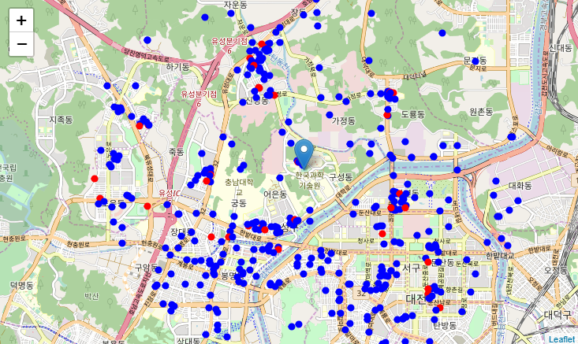
Data
Get Restaurant Location Data near KAIST from Foursquare API

Slide 7
Methodology
1. We will use k-means & DBSCAN to find clusters of restaurants
2. Using visualization optimize clustering.
4. find center location of the clusters and number of Chinese restaurants in the clusters
5. select important clusters
6. find best location for 'Drone Base' based on the distances from the clusters.

Slide 8
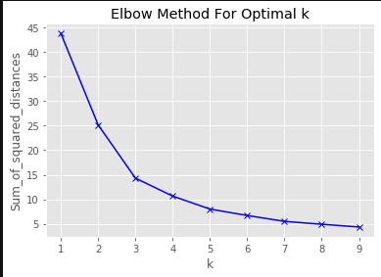
Analysis : k-Means
Use Elbow Method for Optimal k. From this we can find the best k is 5.

Slide 9
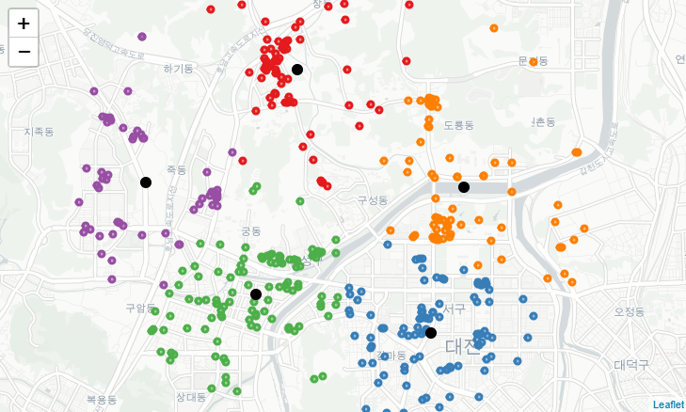

Analysis : k-Means
Draw clusters on the map and check the number of Chinese restaurants in each clusters.

Slide 10
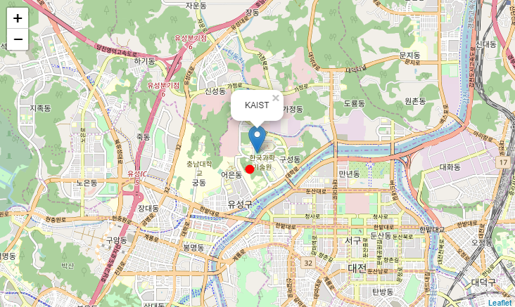
Analysis : k-Means
From the location data of each clusters, we can get center of the centers of the clusters.

Slide 11
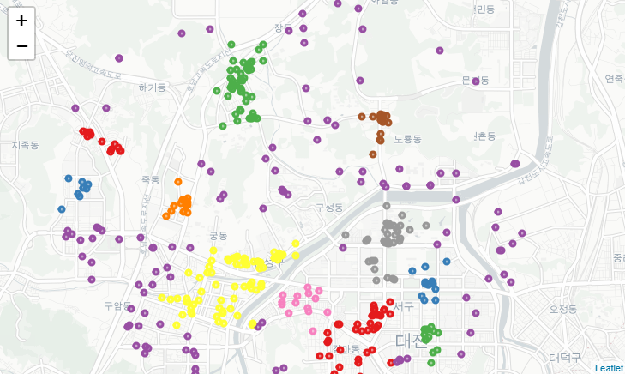
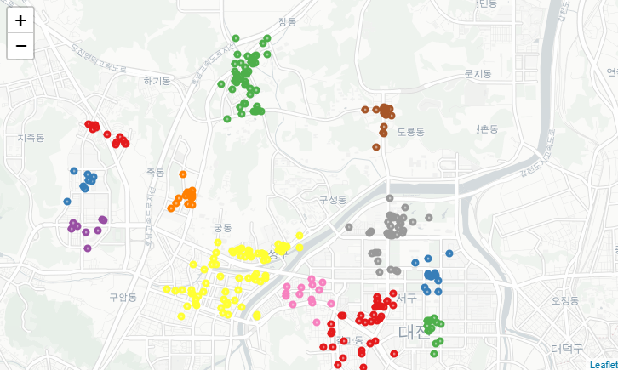
Analysis : DBSCAN
DBSCAN from sklearn.cluster eps = 0.22, min_samples = 8, algorithm='kd_tree'
Remove outliers

Slide 12
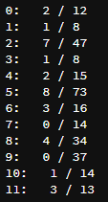
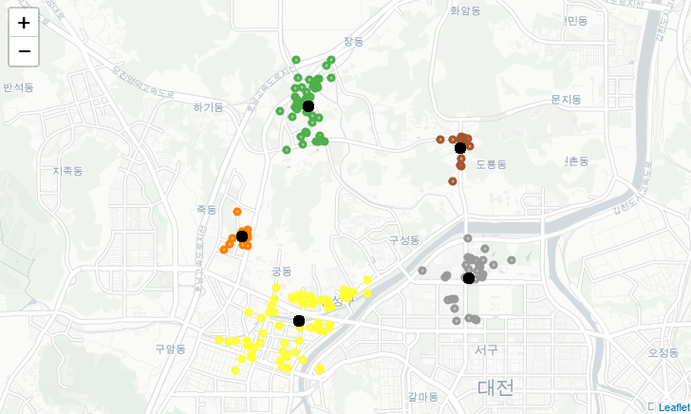
Analysis : DBSCAN
Check the number of Chinese restaurant and total number of restaurant.
Remove group size under 15 and group without Chinese restaurant. → Selected group : 2,4,5,6,8.

Slide 13
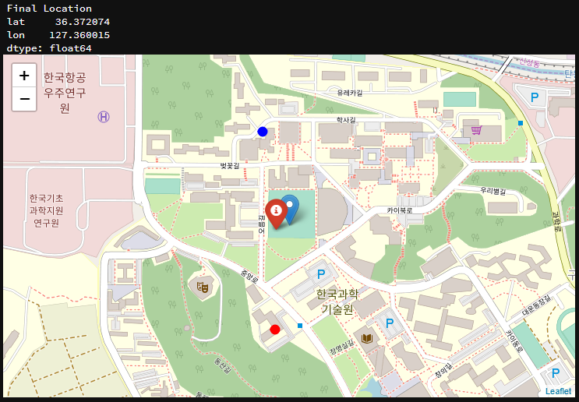
Results and Discussion
1. from k-means : [ 36.369084 , 127.358620 ]
2. from DBSCAN : [ 36.374233 , 127.359663 ]
Final Location : [ 36.372074 , 127.360015 ]

Slide 14
Conclusion
Figure out suitable place for the Food Delivery Service Drone Base.
Get data from Google API and Foursquare
Using k-means & DBSCAN, we find out main restaurants clusters around KAIST.
Count the number of Chinese restaurants in the clusters.
The result of k-means & DBSCAN was different but, the center of the clusters center was almost same.
From this project we get meaningful data for the business.
If we try to develop this project, we can consider about other data in real world.

